Slide 1

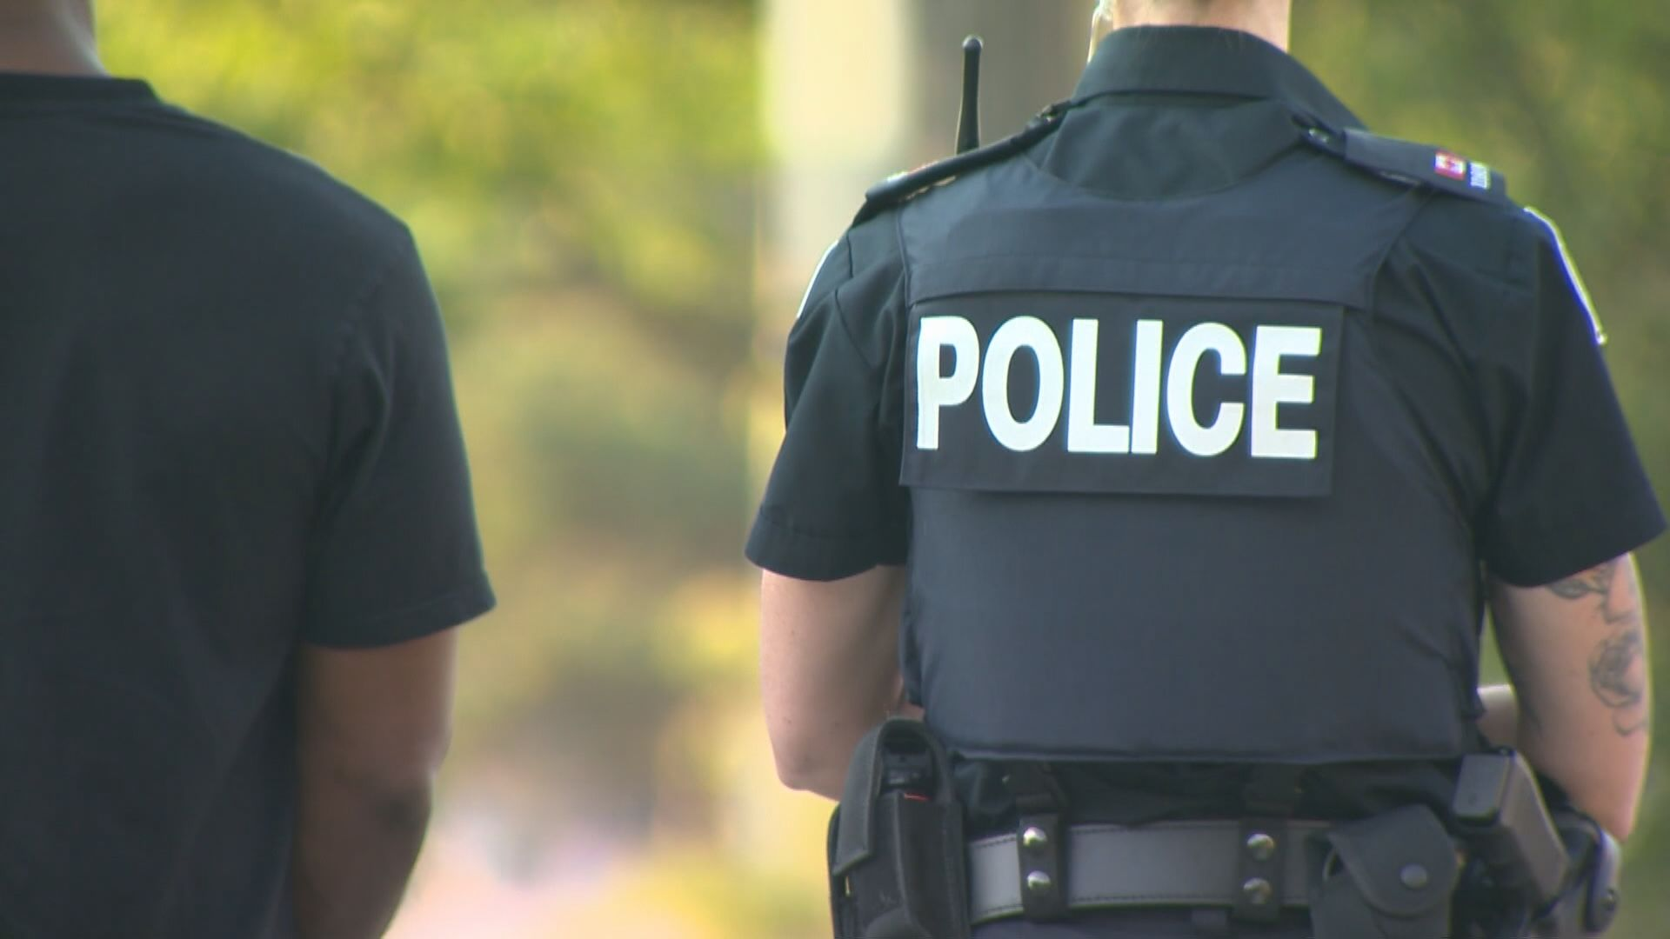
PROJECT 3 –GROUP 10
Andrea wu
Cadeem Musgrove
Diego martorell
Notes:
Cadeem

Slide 2

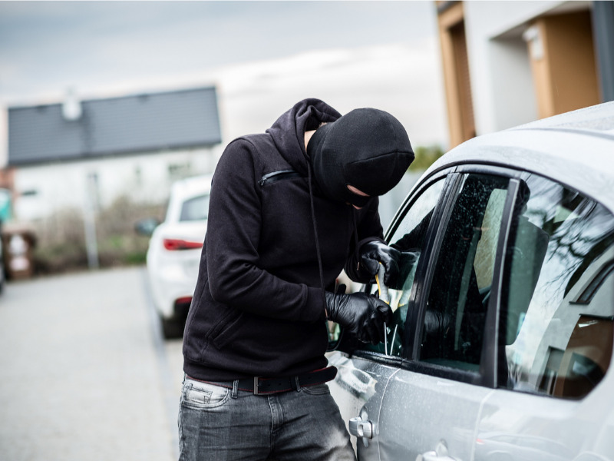
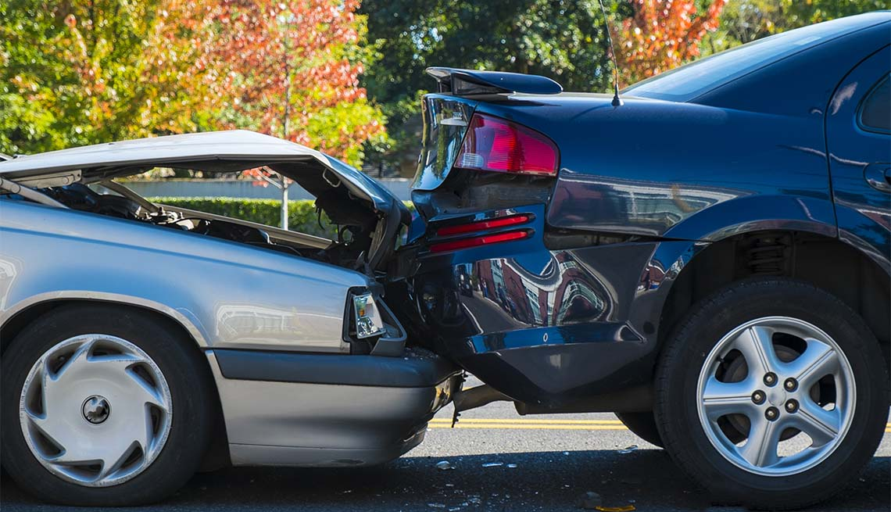
Problem statement
Have you ever wondered where the most traffic accidents and car thefts occur in Toronto?
Notes:
Our dashboard tries to show in a dynamic way the neighbourhoods and specific areas where the most accidents and car thefts occur in Toronto. This would be very interesting for anyone who drives in the GTA. Thanks to our visualizations this person can see in which areas he should be more careful about leaving his car unattended and in which areas he should be driving more carefully to avoid any accidents. (Cadeem)

Slide 3
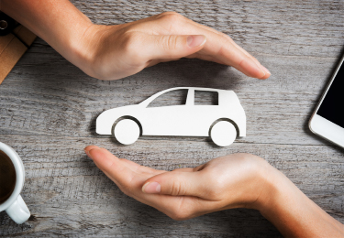
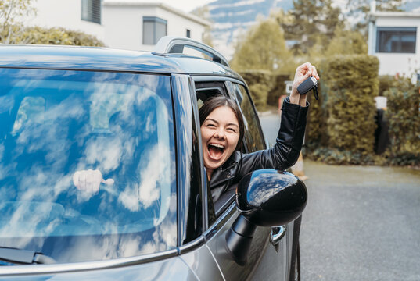

Target Audience
Insurance companies
Car Owners
Policy Makers
Notes:
Cadeem

Slide 4
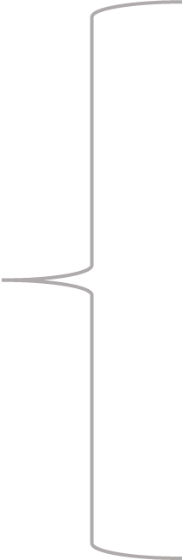

Data collection
Toronto Police Service (Public Safety Data Portal)
Car thefts and car accidents in the GTA (2018-2023)
Excel files (Car theft: 11,829 KB, Car accidents: 3,358 KB)
About our datasets
Incomplete information in the car accident dataset (E.g: Incomplete data about the road conditions where the accidents occurred)
Challenges
Notes:
Diego
We obtained our original databases from the Toronto Police Service website. We decided to work with the data of all car thefts and car accidents that happened in the GTA from 2018 to 2023, Our files were relatively heavy as you can see in the slide since they contained information for the last 15 years but we decided to work with a shorter dataset and that’s why we only decided to work with the timeframe mentioned before. One challenge that we face with these datasets was incomplete information. For example, we wanted to include in our visuals if the accidents happened because the driver had been drinking alcohol but this information was not complete for every single record. The same happened with other fields like for instance there was a field indicating if the driver was speeding but again it was incomplete for the majority of records. Therefore, we decided to not work with these fields which could have been interesting if the data had been complete.

Slide 5
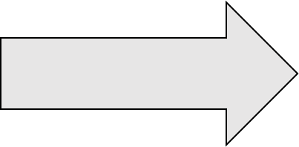
How we prepared our project?
Data cleaning (30-45 min)
Python ( Pathlib, Pandas, Sqlalchemy)
Data Storage (5 min)
Sqlite (For storing our clean database)
JSON (For building our dashboard)
Data Visualization (10-12 hours)
Javascript
Html
Google Visualization
Chart.js
Notes:
Diego
For our data cleaning we used python and the libraries pathlib and pandas to read and remove all unnecessary information from the original excel files that we obtained from the Toronto Police Service Website. Additionally, we also used python to create the json files that we used for our data visualization and we used the library sqlalchemy to create a copy of our clean databases in sqlite format.
For our data storage as I mentioned before we used sqlite and json and lastly for out visualizations we used javascript supported by an html and we used libraries that we haven’t explored in class such as google visualization and chart.js

Slide 6
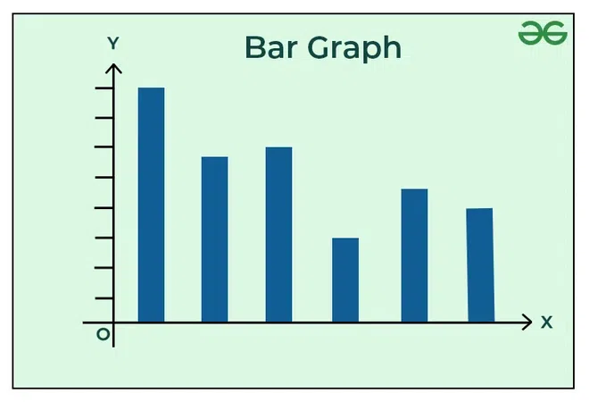
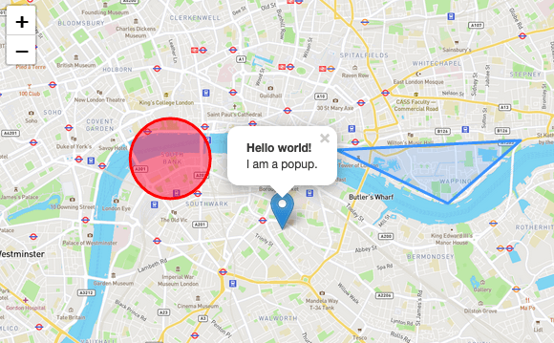
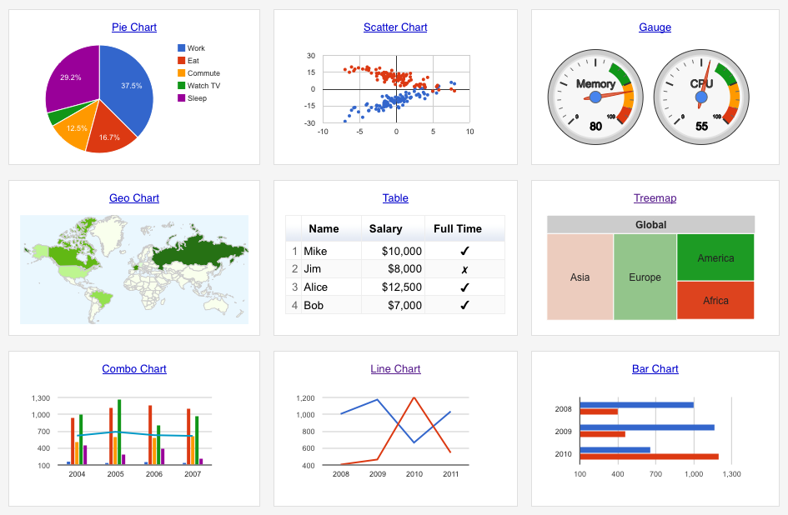
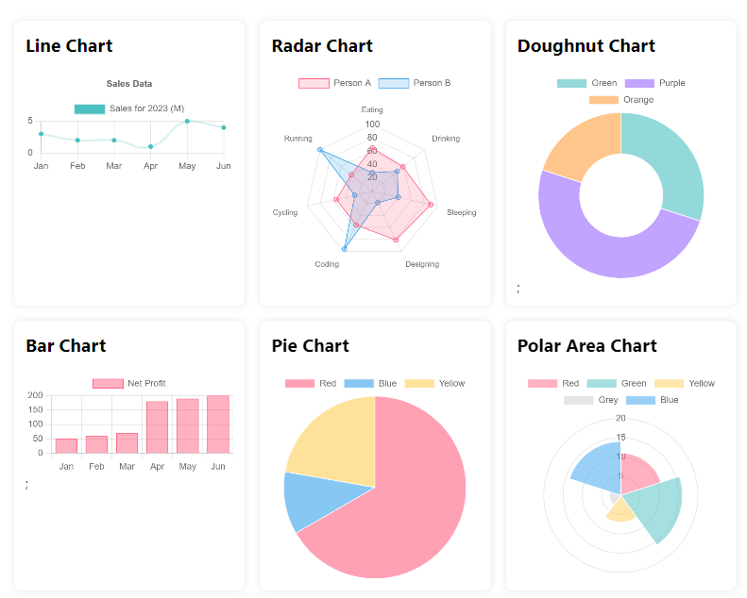
Use cases
Anyone will be able to see on which neighbourhoods more car theft and car accidents occur and try to be more careful in those areas.
Plotly
Our leaflet map can help individuals see where car accidents happen the most in the GTA (A reminder that you have to pay extra attention in those roads)
Leaflet
Our dashboard shows in which road conditions accidents are more likely to occur
Google VIsualization
Our dashboard shows in which age groups involved the most in car accidents
Chart.js
Notes:
Andrea

Slide 7
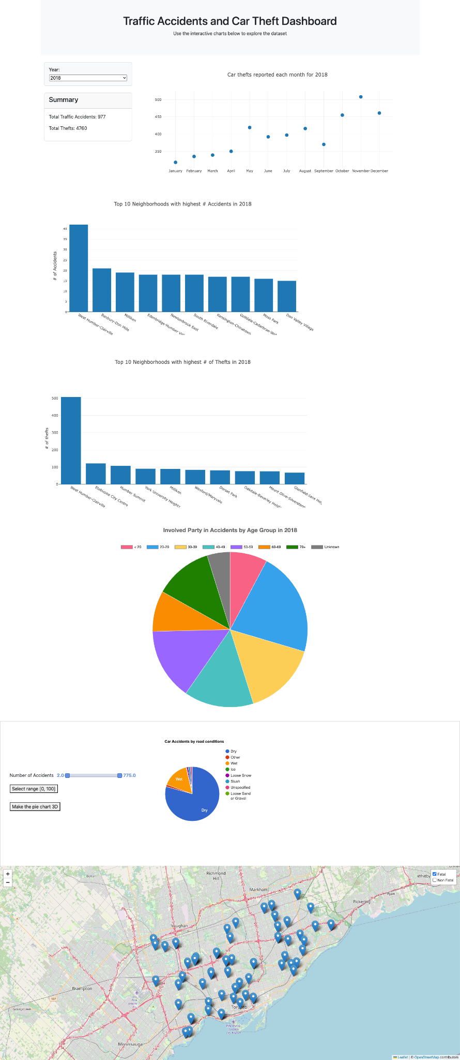
Our Dashboard
Notes:
Andrea

Slide 8
Limitations and Considerations
An exhaustive analysis would need information regarding the reason of why the accident occurred:
Were there third parties involved?
Was the driver driving improperly?
Year-to-year trend is not shown in the dashboard for comparison
No data regarding the current year (2024)
Incomplete information
Ethical considerations
Our dashboard can give negative reputation to specific neighbourhoods and to the individuals who live there
Notes:
Andrea

Slide 9
Future Work Scope
Is crime in Canada increasing in general or only car thefts?
Why exactly some neighbourhoods are more targeted than others?
We could explore the reasons behind why car thefts are occurring more in certain neighbourhoods and add this to our visuals
Are the road conditions optimal in those areas?
The roads have traffic signs and are well-lit?
We could explore the reasons behind why some accidents are more likely to occur in certain roads than in others
Notes:
Cadeem

